Slide 1
Chapter 1: Introduction to Computers and Programming
Starting Out with C++
Early Objects
Eighth Edition
by Tony Gaddis, Judy Walters,
and Godfrey Muganda

Slide 2
Topics
1.1 Why Program?
1.2 Computer Systems: Hardware and Software
1.3 Programs and Programming Languages
1.4 What Is a Program Made of?
1.5 Input, Processing, and Output
1.6 The Programming Process
1-<number>

Slide 3
1.1 Why Program?
Computer – programmable machine designed to follow instructions
Program/Software – instructions in computer memory to make it do something
Programmer – person who writes instructions (programs) to make computer perform a task
SO, without programmers, no programs; without programs, the computer cannot do anything
1-<number>

Slide 4
1.2 Computer Systems: Hardware and Software
Hardware – Physical components of a computer
Main Hardware Component Categories
  Central Processing Unit (CPU)
  Main memory (RAM)
  Secondary storage devices
  Input Devices
  Output Devices
1-<number>

Slide 5
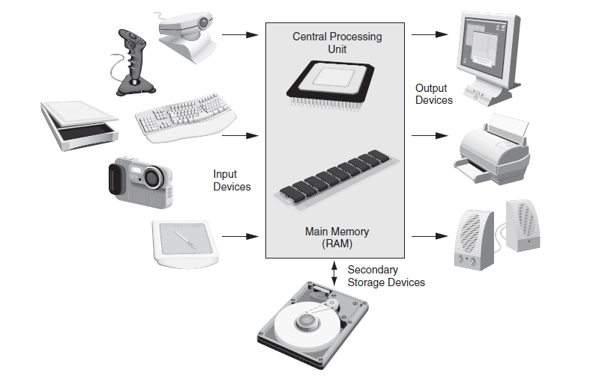
Main Hardware Component Categories
1-<number>

Slide 6
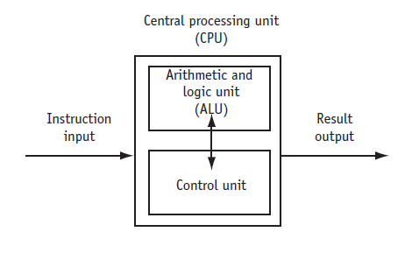
Central Processing Unit (CPU)
CPU – Hardware component that runs programs
Includes
Control Unit
  Retrieves and decodes program instructions
  Coordinates computer operations
Arithmetic & Logic Unit (ALU)
  Performs mathematical operations
1-<number>

Slide 7
The CPU's Role in Running a Program
Cycle through:
Fetch: get the next program instruction from main memory
Decode: interpret the instruction and generate a signal
Execute: route the signal to the appropriate component to perform an operation
1-<number>

Slide 8
Main Memory
Holds both program instructions and data
Volatile – erased when program terminates or computer is turned off
Also called Random Access Memory (RAM)
1-<number>

Slide 9
Main Memory Organization
Bit
  Smallest piece of memory
  Stands for binary digit
  Has values 0 (off) or 1 (on)
Byte
  Is 8 consecutive bits
  Has an address
Word
  Usually 4 consecutive bytes
8 bits
0 1 1 0 0 1 1 1
1 byte
1-<number>

Slide 10

Secondary Storage
Non-volatile - data retained when program is not running or computer is turned off
Comes in a variety of media
  magnetic: floppy or hard disk drive, internal or external
  optical: CD or DVD drive
  flash: USB flash drive
1-<number>

Slide 11

Input Devices
Used to send information to the computer from outside
Many devices can provide input
  keyboard, mouse, microphone, scanner, digital camera, disk drive, CD/DVD drive, USB flash drive
1-<number>

Slide 12

Output Devices
Used to send information from the computer to the outside
Many devices can be used for output
  Computer screen, printer, speakers, disk drive, CD/DVD recorder, USB flash drive
1-<number>

Slide 13
Software Programs That Run on a Computer
System software
  programs that manage the computer hardware and the programs that run on the computer
  Operating Systems
    Controls operation of computer
    Manages connected devices
    Runs programs
  Utility Programs
    Support programs that enhance computer operations
    Examples: anti-virus software, data backup, data compression
  Software development tools
    Used by programmers to create software
    Examples: compilers, integrated development environments (IDEs)
1-<number>

Slide 14
1.3 Programs and Programming Languages
Program
a set of instructions directing a computer to perform a task
Programming Language
a language used to write programs
1-<number>

Slide 15
Algorithm
Algorithm: a set of steps to perform a task or to solve a problem
Order is important. Steps must be performed sequentially
1-<number>

Slide 16
Programs and Programming Languages
Types of languages
  Low-level: used for communication with computer hardware directly.
  High-level: closer to human language
1-<number>

Slide 17
From a High-level Program to an Executable File
Create file containing the program with a text editor.
Run preprocessor to convert source file directives to source code program statements.
Run compiler to convert source program statements into machine instructions.
1-<number>

Slide 18
From a High-level Program to an Executable File
Run linker to connect hardware-specific library code to machine instructions, producing an executable file.
Steps b) through d) are often performed by a single command or button click.
Errors occuring at any step will prevent
execution of the following steps.
1-<number>

Slide 19
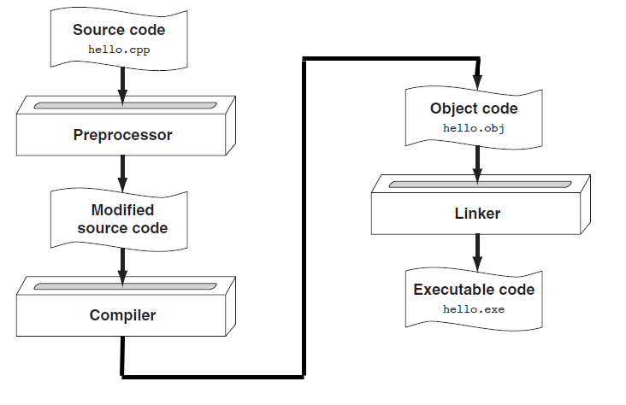
From a High-level Program to an Executable File
1-<number>

Slide 20
1.4 What Is a Program Made Of?
Common elements in programming languages:
  Key Words
  Programmer-Defined Identifiers
  Operators
  Punctuation
  Syntax
1-<number>
Notes:
See pr1-01.cpp

Slide 21
Example Program
#include <iostream>
using namespace std;
int main()
{
double num1 = 5,
num2, sum;
num2 = 12;
sum = num1 + num2;
cout << "The sum is " << sum;
return 0;
}
1-<number>

Slide 22
Key Words
Also known as reserved words
Have a special meaning in C++
Can not be used for another purpose
Written using lowercase letters
Examples in program (shown in green):
using namespace std;
int main()
1-<number>

Slide 23
Programmer-Defined Identifiers
Names made up by the programmer
Not part of the C++ language
Used to represent various things, such as variables (memory locations)
Example in program (shown in green):
double num1
1-<number>

Slide 24
Operators
Used to perform operations on data
Many types of operators
  Arithmetic: +, -, *, /
  Assignment: =
Examples in program (shown in green):
num2 = 12;
sum = num1 + num2;
1-<number>

Slide 25
Punctuation
Characters that mark the end of a statement, or that separate items in a list
Example in program (shown in green):
double num1 = 5,
num2, sum;
num2 = 12;
1-<number>

Slide 26
Lines vs. Statements
In a source file,
  A line is all of the characters entered before a carriage return.
  Blank lines improve the readability of a program.
  Here are four sample lines. Line 3 is blank:
  1. double num1 = 5, num2, sum;
  2. num2 = 12;
  3.
  4. sum = num1 + num2;
1-<number>

Slide 27
Lines vs. Statements
In a source file,
  A statement is an instruction to the computer to perform an action.
  A statement may contain keywords, operators, programmer-defined identifiers, and punctuation.
  A statement may fit on one line, or it may occupy multiple lines.
  Here is a single statement that uses two lines:
  double num1 = 5,
  num2, sum;
1-<number>

Slide 28
Variables
A variable is a named location in computer memory (in RAM)
It holds a piece of data. The data that it holds may change while the program is running.
The name of the variable should reflect its purpose
It must be defined before it can be used. Variable definitions indicate the variable name and the type of data that it can hold.
Example variable definition:
  double num1;
1-<number>

Slide 29
1.5 Input, Processing, and Output
Three steps that many programs perform
  Gather input data
    from keyboard
    from files on disk drives
  Process the input data
  Display the results as output
    send it to the screen or a printer
    write it to a file
1-<number>

Slide 30
1.6 The Programming Process
Define what the program is to do.
Visualize the program running on the computer.
Use design tools to create a model of the program.
    Hierarchy charts, flowcharts, pseudocode, etc.
Check the model for logical errors.
Write the program source code.
Compile the source code.
1-<number>

Slide 31
The Programming Process (cont.)
7. Correct any errors found during compilation.
8. Link the program to create an executable file.
9. Run the program using test data for input.
10. Correct any errors found while running the program.
Repeat steps 4 - 10 as many times as necessary.
11. Validate the results of the program.
  Does the program do what was defined in step 1?
1-<number>

Slide 32
Chapter 1: Introduction to Computers and Programming
Starting Out with C++
Early Objects
Eighth Edition
by Tony Gaddis, Judy Walters,
and Godfrey Muganda

